Slide 1
The Foundation for Food and Agriculture Research
Council on Governmental Relations
October 23, 2015

Slide 2
Agenda
Introduction to FFAR
First 12 Months: Progress and Current Status
Major Milestones in 2015
Looking Ahead: Potential Projects
Q&A

Slide 3
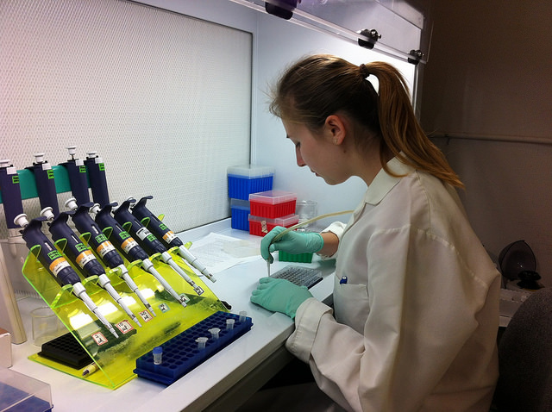
About FFAR
We build unique partnerships to support innovative research addressing today’s challenges in food and agriculture.

Slide 4
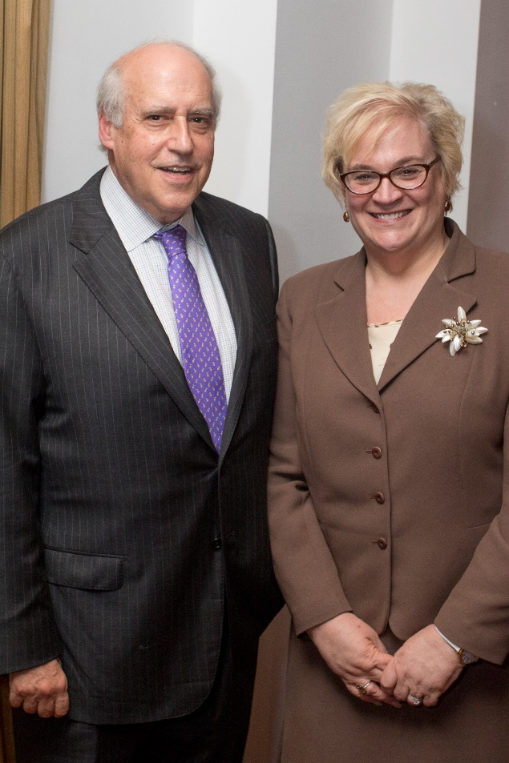
Who We Are
Independent 501 (c) (3) organization
20-Member Board of Directors
Chaired by former Secretary of Agriculture Dan Glickman
5 ex officio members representing NSF and USDA, including Secretary Thomas Vilsack and Chief Scientist Dr. Cathy Woteki
Growing staff of three
Notes:
20-member board representing USDA and NSF, private sector including industry, growers, other foundations, and academia
Current staff: Katy Raymond, chief of staff and Madeleine O’Connor, communications officer
Hiring 2 Scientific Program Directors and a Director of Development

Slide 5
Who We Are – FFAR Board
14 Voting Members
Dr. Kathryn J. Boor, Cornell University
Dr. Doug Buhler, Michigan State University
Dr. Nancy Creamer, North Carolina State University
Dr. Deborah Delmer, University of California Davis
Hon. Dan Glickman, Chairman of the Board, Aspen Institute
Dr. Rob Horsch, Bill and Melinda Gates Foundation
Ms. Pamela Johnson, National Corn Growers Association
Dr. Mark Keenum, Mississippi State University
Dr. Michael Ladisch, Purdue University
Dr. Christopher Mallett, Cargill Inc.
Dr. Terry F. McElwain, Washington State University
Dr. Stanley Prusiner, University of California - San Francisco
Dr. Yehia “Mo” Saif, Ohio State University
Dr. Barbara Schaal, Washington State University

Slide 6
Who We Are – FFAR Board
5 Ex oficio Members
Thomas Vilsack Secretary of Agriculture
Dr. France Córdova, Chair, National Science Foundation
Dr. Catherine Woteki, Chief Scientist and Under Secretary for Research, Education and Economics, USDA
Dr. Sonny Ramaswamy, NIFA Director, USDA
Dr. Chavonda Jacobs-Young, AFRI Administrator, USDA

Slide 7
What We Know to be True
9 billion people are projected to populate the world by 2050
Our current food system must evolve to sustainably support the growing global community
That transformation will depend on innovative research from the best and brightest scientists
Therefore, FFAR is committed to shining a spotlight on food and agriculture science as a cutting edge field

Slide 8
How FFAR Will Work
Fund cutting-edge research and development through grants and challenges
Build unique public-private partnerships
Convene stakeholders and thought leaders to foster collaboration
Build human capacity to advance innovation

Slide 9
Partnership
Public-private partnership is a key part of FFAR’s operating model
All projects require matching funds from a non-Federal partner; FFAR's ability to leverage/multiply dollars sets the foundation apart
Charged with complementing, not duplicating USDA-funded efforts

Slide 10
Grants
As a non-governmental organization, FFAR can be nimble
RFA processes will be simple, streamlined, and transparent
Competitive and non-competitive projects
Will continue to consider unsolicited proposals; we welcome short-form project ideas from any and all interested groups

Slide 11
Our History
2014 - 2015
FFAR authorized in July 2014 Farm Bill
Received $200 M in startup funds
Formed and convened the Board
Began priority-setting and strategic planning
Announced initial research target areas
First executive director joined FFAR in September 2015
Notes:
[Previous unofficial interim ED McKenna brought financial and executive expertise to FFAR, given his current role with the USDA’s rural development office and previous experience as CEO of national nonprofit Keep America Beautiful and a finance executive at PepsiCo.

Slide 12
Initial Research Target Areas
More productive, sustainable agriculture
Better health through food
1
Improving plant efficiency
5
Achieving a deeper understanding of nutrition and healthful food choices
2
Optimizing agricultural water use
6
Managing food production systems to enhance human nutritional outcomes
3
Transforming soil health
4
Enhancing sustainable farm animal productivity, resilience, and health
7
Spurring food system innovation
Fund cutting edge R&D
Convene to foster collaboration
Build innovative partnerships
Build human capacity
Copyright © 2015 Foundation for Food and Agriculture Research
Notes:
Currently soliciting feedback from a variety of stakeholders; will refine these seven areas according to input from public and private entities
Areas are intentionally broad; Foundation will look to fund innovative projects that will have the greatest impact.
(Pause here for feedback return to this slide at the end?)
Do these topics resonate with you? What's missing?
Do you have any potential ideas for projects within or outside these priorities?
In your opinion, which of these priorities would be the most fundable?
Would any of these areas be so redundant as to be unproductive for FFAR to focus on considering other research work being done?

Slide 13
Looking Ahead
Active board committees developing policies and procedures
Seeking input from public and private sector regarding initial research target areas
Hiring 3+ staff members
Planning to assemble seven Scientific Advisory Councils
October 2015 Board Meeting:
Includes public session as forum for stakeholder recommendations for FFAR
Inaugural project announcements expected to follow October board meeting
Notes:
Board committees: executive, development, finance, governance, scientific review

Slide 14
Proposed Projects
The following four projects are in various stages of development and will be voted on at FFAR’s October board meeting
Public announcement is anticipated following the board meeting
Notes:
- Both ideas are currently under discussion by the board; no final decision will be made until Dr. Rockey joins the Foundation in September
Both ideas manifest FFAR’s goal to build human capacity in agricultural research
We are in discussions with potential partners for the prize. Current thinking is that it would be awarded to a mid-career scientists who had made remarkable achievements in the food and agriculture space.

Slide 15
Early Career Fellowships
Unmet need: The New Innovator in Agriculture Research award will support and spotlight the next generation of scientists
Up to $200,000/year over 3 years to provide rare financial freedom for early-career faculty members to pursue innovative research
Recipients will be committed to mentoring
Research in 1 or more FFAR focus areas
Currently seeking inaugural co-funders

Slide 16
National Prize
Partner: National Academy of Sciences
Unmet need: Prestigious recognition for scientists in food and agriculture
Anticipated award: $100,000 for one annual or biennial recipient
Notes:
Acknowledge Wolfe Prize and World Food Prize

Slide 17
Rapid Response Fund
Unmet need: Rapid deployment of funds to mitigate potential damage in the face of unanticipated threats to food supply
Criteria for project selection:
Acute
National
Tangible outcomes
Considering several funding models
Notes:
Examples include major animal disease outbreaks such as avian influenza, major weather events such as the drought in the western US, impacts of major trade deals or embargos, food safety crises and other major events.
professionals to execute a targeted and swift response to a crisis.
Primary requirements
National level problem and a threat to the nation’s food supply
A defined crisis of acute nature
Tangible outcomes from the project
Secondary requirments
No other funds available
Potential to provide unique information that will prevent similar crises in the future

Slide 18
Proposed Soil Health Project
Unmet needs:
Systems approach to cover crops, soil health
National network to address these issues
Outcomes
FFAR will fund key research related to soil health
Widespread adoption of no till, cover crops and other soil health practices
Notes:
Outcome: Widespread adoption of no till, cover crops and other soil health practices

Slide 19
Thank you!
Q&A
Contact Us
Dr. Sally J. Rockey, Executive Director
s.rockey@far.foundation
Madeleine O’Connor, Communications Officer
m.oconnor@far.foundation | 202.590.7613
Katy Raymond, Chief of Staff
k.raymond@far.foundation
Connect with FFAR:
www.far.foundation
@FoundationFAR
@RockTalking

